Slide 1
Slide-deck for onboarding leaders/chairs/co-chairs of Committee/Council/SIGs/RIGs
Version 1.10

Slide 2
How to Use this Slide Deck
This is ISPE's slide deck for new chairs of Committees, Councils, SIGs, and RIGs. It was current as of August 2024 and updated annually.
The slide deck contains information pertinent to ISPE leadership.
Please send any questions or suggestions for improvement to Erin at the Executive Office: erin@pharmacoepi.org
Thanks for representing ISPE!

Slide 3
CONTENTS
Welcome New ISPE Committee, Council, SIG, and RIG leaders
Snapshot of ISPE in 2024
ISPE Membership Engagement
Responsibilities of Chairs and Groups
Staff Support
Specific Topics of Interest Across Groups
  Communications within ISPE
  Strategic Efforts
  ISPE Manuscript Initiative and Public Policy Endorsement
  Webinars
  Social Media
  Other Notes
Strategic Plan 2024-2029
Q&A
Notes:
Elisabetta – Slides 2 – 30
Jenny – Slides 31-54

Slide 4
What is ISPE?
An international association dedicated to advancing the health of the public by:
Providing a global forum for the open exchange of scientific information on drugs, biologics, and devices; delivery, use, costs and value; adverse and beneficial effects; and therapeutic risk management
Sponsoring educational opportunities
Advocating for pharmacoepidemiology, including research in pharmacovigilance, drug utilization, comparative effectiveness, and therapeutic risk management

Slide 5
Membership 2023: Geographic Breakdown
Current membership (Aug 2023)
3,170 in 68 countries
EMEA = Europe, Middle East, and Africa

Slide 6
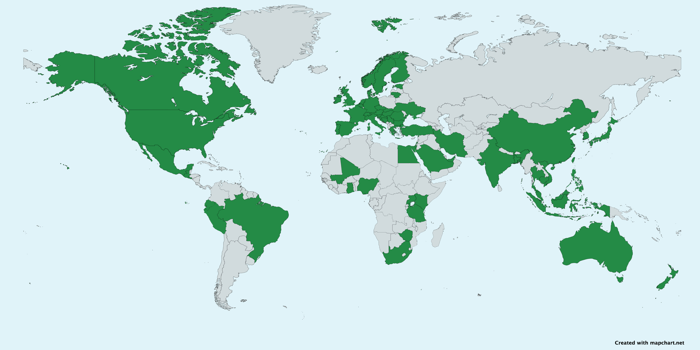

Slide 7
ISPE's Organization
Members
Executive Committee
Board of Directors
Executive Office
Executive Secretary
Staff
Journal Editor
4 Councils
3 Regional Interest Groups (RIGs)
21 Special Interest Groups (SIGs)
27 Student Chapters
16 Committees

Slide 8
When volunteering for any leadership role in ISPE you need to be aware of the commitment requested in terms of time and travel (participation in annual meeting and/or Mid-year meeting)

Slide 9

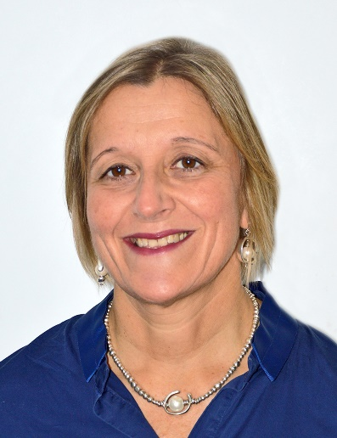
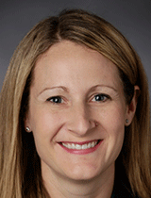
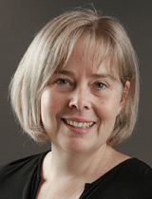

ISPE Executive Committee, 2024-2025
Mary Beth Ritchey, FISPE President | Ursula Kirchmayer, FISPE President-elect | Jennifer Christian, FISPE Vice President/Finance
Lisa Pont, FISPE Immediate Past President | Matthew Clark Executive Secretary

Slide 10
ISPE Board of Directors, 2024-25
Keiko Asao, Industry/Service Provider (Asia/Pacific)
Gillian Caughey, Academic (Asia/Pacific)
Marianne Cunnington, Industry/Service Provider (Europe/Africa)
Stanley Edlavitch, Executive Director, emeritus
Efe Eworuke, Government/Regulator (Americas)
Jessica Franklin, Industry/Service Provider (Americas)
Juan Hincapie-Castillo, Academic (Americas)
Andrea Margulis, Industry/Service Provider (Europe/Africa)
Daniela Moga, Board member at large
Stine Hasling Mogensen, Government/Regulator (Europe/Africa)
Mette Nørgaard, Academic (Europe/Africa)
Elisabetta Patorno, Academic (Americas)
Christopher Rentsch, Academic (Europe/Africa)
Jeremy Rassen, Industry/Service Provider (Americas)
Yoshiaki Uyama, Government/Regulator (Asia/Pacific)
Kristian Filion, Board member at large

Slide 11
Principles of Committees
16 standing committees as of 2024
Represent the "working arm" of ISPE
Each Committee is formally designated by the Board for a specific purpose
Each Committee must have a mission, agreed by the Board and published in the Policy Manual
The body of work of committees is ongoing (not just at annual meetings)
While retaining a degree of autonomy, committees are directly responsible to the Board and dependent on Board approval prior to incurring obligations on the part of the Society
Committees must report to the Board semi-annually
  Subcommittees are accountable to their respective parent committees

Slide 12
Member Involvement - 1
Committees:
Run ISPE's programs, projects, and special initiatives and oversee general operations
Committees Open to all Members
ACPE Steering
Development
Global Development
Membership
Public Policy
Publications & Communications
Education
Archives & History
Finance
Sustainability
  Bylaws, Policies, Procedures
  Fellowship and Awards
  Management Oversight
  Nominating
  Scholarship
  ICPE Scientific Program
  MYM Scientific Program
  Strategic Planning
By Board appointment or policy only
Notes:
ISPE MYM is paused in 2025. In the future, we intent to change the traditional MYM format (alternating between Europe and North America) and give regional meetings the space to host a MYM. This is a work-in-progress, and more information about this change and transition will be forthcoming.

Slide 13
Principles of Councils
The same as committees with the exception that the councils have been created to deliberate sector-specific issues
Therefore, their governance is self-determining, subject to approval by the Board

Slide 14
Principles of SIGs
The same as committees with the exception that SIGs have been created to address specific scientific issues/interests
Therefore, their governance is self-determining, subject to approval by the Board
However, guidelines have been developed (e.g., selection of Chairs)

Slide 15
Member Involvement - 2
Councils: Represent the four key sectors of ISPE membership | Academic Government/Regulatory Industry/Service Provider Student
Special Interest Groups (SIGs): Facilitate interactions among those with interests in specialized areas within pharmacoepidemiology. | Adherence Asian Pharmacoepidemiology Network (AsPEN) Benefit Risk Assessment, Communication and Evaluation (BRACE) Biologics Cancer Cell & Gene Therapy Comparative Effectiveness Research (CER) Databases Digital Epidemiology Drug-Drug Interaction | Drug Utilization / Health Services Research Environmental Pharmacoepi Genomics & Precision Medicine Geriatric Pharmacoepi Health Equity Medical Devices Medications in Pregnancy & Lactation (MiPaL) Pediatrics Rare Disease RWE Collaborative Vaccines

Slide 16
ISPE in 2024: Principles of RIGs
The same as committees with the exception that RIGs have been created to address specific regional issues/interests
Therefore, their governance is self-determining, subject to approval by the Board
However, guidelines have been developed (e.g., selection of Chairs)

Slide 17
Member Involvement - 3
Regional Interest Groups (RIGs): Facilitate interactions among those with interests in pharmacoepidemiology in specific regions of the world. | African Regional Interest Group Latin American Regional Interest Group Gulf Region Interest Group

Slide 18
Policies on Activities of Committees, Councils, SIGs, and RIGs
Committee principles are covered in section 5.1 of the policy manual
Principles for Councils, SIGs, and RIGs are the same as Committees except when noted in sections 5.2, 5.4, and 5.5 of the policy manual, respectively
Policies for each specific Committee, Council, SIG, and RIG are in section 11 of the policy manual
Policy manual: https://www.pharmacoepi.org/resources/policies/

Slide 19
Committees

Slide 20
Role of committee chairs
Each committee has a chair and vice chair (or co-chairs) accountable to President-Elect
  These roles are preferably filled by members from different continents
  Co-chairs may be appointed instead of chair/vice chair, if agreed by Exec Committee
  Retiring committee chairs remain in leadership role as past chair

Slide 21
Appointment of committee chairs
Committee nominates members for chair/vice chair based on democratic and transparent process
Vote may be held if there is more than one candidate
Chair/vice chair (co-chairs) is formally appointed by Executive Committee
  NOTE: if no candidates, an individual selected by the Executive Committee assumes these roles
Terms: Staggered terms (variable by committee; often, the vice chair will transition to chair role after two years and a new vice chair is selected/appointed)

Slide 22
Duties of committee chairs
Chair (or delegate) takes minutes and circulates to committee members and Board (copy kept by Executive Secretary/management company)
Chair attends Board meetings (if unable to attend, makes arrangement for vice chair or other Committee member to attend)
Chair runs annual committee meetings at ICPE
Chair ensures committee objectives are met -- all committee activities should be under the auspices of the committee leadership and membership
Chair submits budget request (up to $500*) and justification to Executive Secretary (copy Vice President Finance) by January 1 for inclusion in draft budget for subsequent fiscal year (beginning in July)
Vice chair substitutes for chair if the chair is unavailable
Committees must provide reports to Board and ISPE membership. A template for the report is available
* More than $500 may be available in support of Strategic Plan 2024 – contact Finance Committee for more information

Slide 23
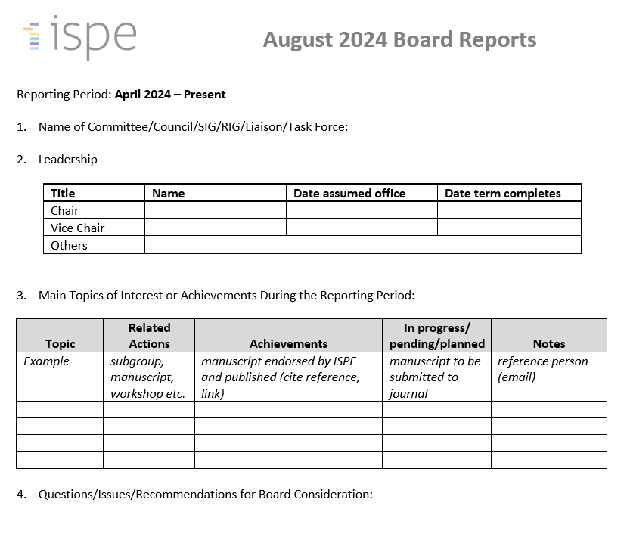
Board Report Template will be available ~1 month before due date
Notes:
The board report will be provided to the Chairs and Vice Chairs of each group via email (and calendar invite) ahead of the scheduled Board meetings.

Slide 24
Appointment or confirmation of members
Volunteers for committees are solicited in July each year and also during and after the annual meetings
Membership is by annual appointment or confirmation by committee chair
Number of members within a given committee should be manageable and appropriate to the committee’s purpose
  Volunteers not appointed should be notified and their continued interest/willingness to serve be recorded
  Committees open to all members typically include all those who indicate interest
  Where logically feasible, committee meetings should be open to all ISPE members, however only official committee members may vote

Slide 25
Annual Calendar for Committees
July –
  Call for interested members
  Submit report to Board; review and present accomplishments for past year
August –
  Chair and co-chair confirmed for upcoming year;
  Committees meet at ICPE
  Chair attends ICPE Board meeting
  Review missions and work plans
September – Follow-up call for interested members
  Committee membership for coming year proposed/accepted
Fall – new committee structure and chairs posted on ISPE website
Spring – Committees present status reports to Board at mid-year meeting
Ongoing –
  Committee work continues
  Periodic meetings and communication as appropriate

Slide 26
Committee Meetings
Arrange at least one annual meeting
  Depending on committee’s activities, meetings may be more frequent
  Chose and announce time and place so that maximum number of committee members can attend
Meetings at ISPE Annual Meeting
  Should not conflict with conference program
With written request, ISPE office will assist in making arrangements for committee meetings

Slide 27
Communicate with members
After the annual conference and the closure of the call for volunteers, chairs receive a list of the members who have expressed interest and are expected to contact the members of their community
Invite new members to subscribe to your community on Exchange
Communicate regularly with members of committee using Exchange
Expectation is for communication a minimum twice per year
Increased communication during time where active work is being done; courtesy communication when there is less activity

Slide 28
Committee Reports
Chair must submit a written report semi-annually to the Board detailing the committee’s activities, annual goals/objectives, work plan, and milestones achieved within the preceding year
  If Board action is required, Chair makes any necessary Board presentation
  General timing of reports:
    July for ICPE Board meeting
    March for mid-year Board meeting
ISPE membership should be kept informed of committee activities by publication of annual report posted on ISPE website
  Posted report is from the Board meeting at the ISPE Annual Meeting
Obtain current report templates from the Executive Secretary/management company

Slide 29
Subcommittees and activities
Committees may organize subcommittees or working groups to address a specific volume of work that arises
Subcommittees are under the purview of the committee chairs
  Activities of subcommittees should be included in committee reports to the Board
  Subcommittee chairs are not expected to attend or present separate reports to the Board

Slide 30
Specific issues for leaders of “closed” committees
Bylaws, Policies, Procedures, Fellowship and Awards, Management Oversight, Nominating, Scholarship, ICPE Scientific Program, MYM Scientific Program, Strategic Planning
Appointment of members by the Board
Chair and vice chair appointed by the Exec upon proposal by the committee members (except for nomination by position, e.g. SPC), see next slide
Staggered two/four-year terms: vice chair steps in as chair after two years
Transition between chairs must warrant continuity of duties inside and outside the committee
Specific information in the policy manual, chapter 11.1

Slide 31
Chairs of closed committees

Slide 32
Councils
Notes:
Transition to Jenny

Slide 33
Differences from Committees
Membership – open to all with primary occupational affiliation within the sector represented
Leadership – chair and vice chair elected by membership, subject to concurrence by Executive Committee
  Student Council –annually elected vice-chair role (followed by chair role for one year)

Slide 34
SIGs

Slide 35
Differences from Committees
Formation – Board confirmation after acceptance of petition by at least 5 ISPE members (including at least one FISPE)
Leadership –
  Chair and vice chair elected by membership, subject to concurrence by Executive Committee
  Staggered, 3-year terms recommended (chair and vice-chair)*
Meetings at ICPE – request meeting time from the Scientific Program Committee
Removal – SIG status may be removed by:
  Request from SIG; Board action; or if no evidence of sustained activity is show (e.g., failing to submit reports to the Board at least once a year) – NOTE: probation would occur before removal due to inaction
* Many SIGs have vice chair → chair → immediate past chair, with members serving for one year in each role

Slide 36
RIGs

Slide 37
Differences from Committees
Formation
  Proposal submitted to Global Development Committee by at least 5 ISPE members (including at least one FISPE) including: region, mission of group
  Global Development Committee leadership recommendation to Board
Leadership
  Chair and vice chair elected by membership, subject to concurrence by Executive Committee
  Staggered, 3-year terms recommended
Meetings at ISPE Annual Meeting – request meeting time from the Scientific Program Committee
Removal – RIG status may be removed by:
  Request from RIG; Board action; or if no evidence of sustained activity is show (e.g., failing to submit reports to the Board at least once a year) – NOTE: probation would occur before removal due to inaction

Slide 38
Staffing Support to Leaders and Members
Full staff support to nearly all committees
  Notable exceptions include Management Oversight; a limited role with Bylaws, Policies & Procedures and councils.
  In broad terms (policy manual specifics notwithstanding) this means:
    Supporting the chair in his/her duties
    Helping organize meetings; collaborating on developing meeting agenda
    Preparing reports and conducting research in support of agenda items
    Drafting meeting minutes
    Maintaining lines of communication within the committee
    Implementing and managing programs that support the committee or council's purpose

Slide 39
Kellen Staff Support for Standing Committees
ACPE Intl Steering
Matt Clark
Archives & History
Amanda Gaster
Bylaws, Policies & Procedures
Matt Clark
Development
Emily Hornung
Education
Amanda Gaster
Fellowship & Awards
Matt Clark
Finance
Matt Clark
Global Development
Erin Maas
Management Oversight
Matt Clark
Membership
Nakeshia Betsill
Erin Maas
Nominating
Matt Clark
Public Policy
Matt Clark
Publications & Comms
Erin Maas
Scholarship
Matt Clark
ICPE Scientific Program
Matt Clark, Erin Bellotti, Amanda Gaster
Further support
Councils: Amanda Gaster
Website: Tori Reeder
Webinars: Trish Harley
Accounting: Howard Burkat
Social Media: Jordan Brown
Marketing: Tori Reeder
MYM Scientific Program
Matt Clark, Erin Bellotti, Amanda Gaster
Strategic Planning
Matt Clark
Sustainability
Erin Bellotti
Still unsure? Email info@pharmacoepi.org – all staff access this mailbox

Slide 40
Specific Topics of Interest

Slide 41
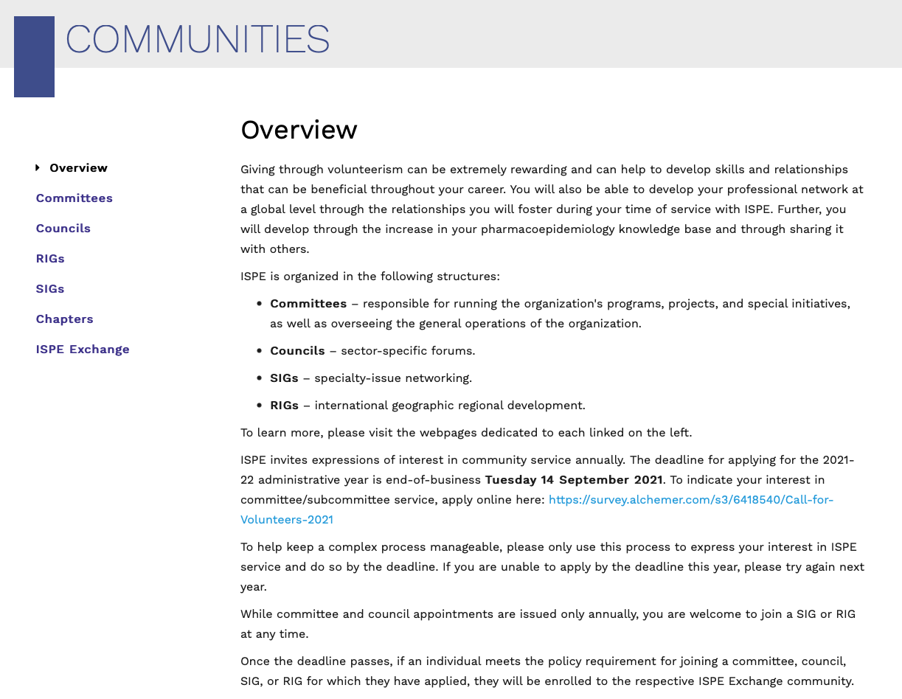
Communications within ISPE
Utilize ISPE Exchange
  File repository for meeting minutes
  Discussion board for continued communication
  between meetings
  Can have updates sent to your email
  “How-to” available within ISPE Exchange
  For all communication in EXCHANGE please make sure to limit conversation to
  topics of the community or ISPE, avoiding commercial contents and maintaining “good communication practices” in line with the upcoming EXCHANGE etiquette guide
Website
  Each Committee, Council, SIG, and RIG has page on website
    Update annually by sending updates to executive office
  Location: https://www.pharmacoepi.org/communities/overview/

Slide 42
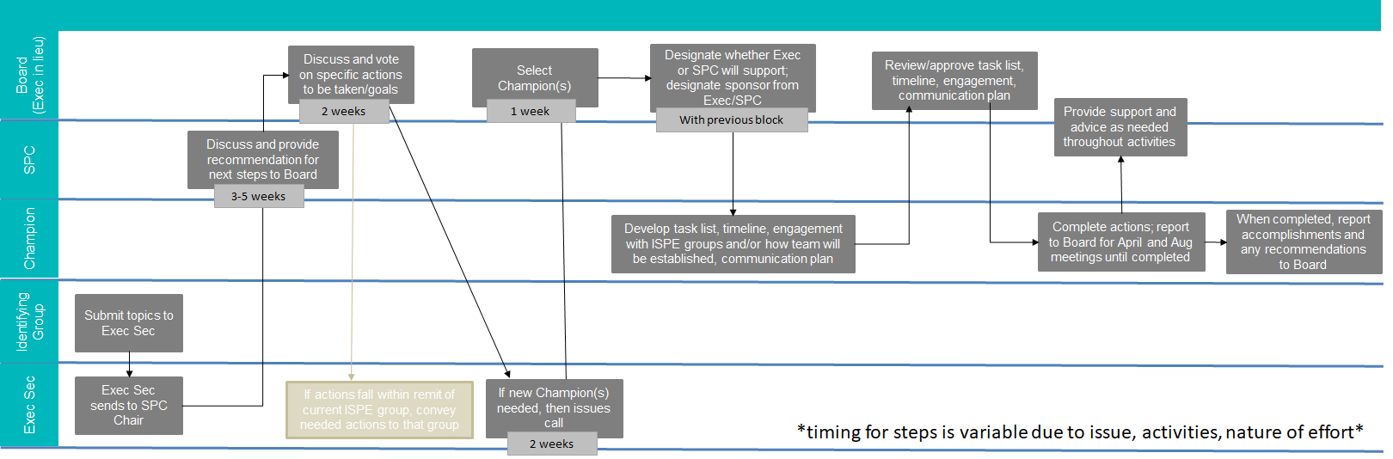
Strategic Efforts
Any ideas for activities to address short-term timebound needs (e.g., review of guidance documents) or long-term strategic needs (e.g., role of PE re: artificial intelligence) will go through the above process.
Note: The first step is to submit the topic/idea to the Executive Secretary using the following link:
https://survey.alchemer.com/s3/8023410/ISPE-Coordination-of-Strategic-Efforts-Topic-Submission-Form
More detail to be provided on the website in the future.
Notes:
Big picture issue/concern →
Short-term needs across the organization (e.g., review of guidance documents) need to go through

Slide 43
ISPE Manuscript Initiative and Public Policy Endorsement
ISPE funds annual competitive submission program supporting development of manuscripts for guideline development, or reference documents for pharmacoepidemiology.
Writing groups can develop and submit public policy pronouncements, or comments to public consultations of national or international regulatory entities for ISPE endorsement
ISPE's open and transparent process involves full membership consultation ahead of board endorsement vote, final work published online, or funding of Open Access where applicable

Slide 44
Manuscript Proposals
Timeline
  May - July – call for manuscript proposal
  September – proposal deadline
  October – reviewer comments to writing teams
  November – additional reviewer comments to writing teams
  December – notification of selected manuscript proposals
See Technical Appendix B in policy manual or website for description of entire process: https://www.pharmacoepi.org/strategic-initiatives/ispe-funded-manuscripts/
The application materials state a preference for publication in Pharmacoepidemiology and Drug Safety, the official ISPE journal. If another journal is preferred, a rationale for this decision must be provided.

Slide 45
Public Policy Endorsement
Any document, guideline, policy, commentary on pharmacoepidemiology issues which is developed by a writing group associated with ISPE has the potential to be viewed by the wider world as being affiliated with ISPE.
Such documentation must either:
  Contain clarifying language disclosing that the document reflects the author’s personal views and does not necessarily reflect those of ISPE or any group associated with ISPE
  Undergo the ISPE Public Policy endorsement process
See Technical Appendix B in policy manual or website for description of entire process: https://www.pharmacoepi.org/strategic-initiatives/ispe-endorsed-manuscripts/

Slide 46
Webinars
The Education Committee oversees operations of ISPE’s Webinars and other educational programs
If your group is interested in hosting a webinar, submit this form to the Education Committee: https://survey.alchemer.com/s3/6855291/ISPE-Webinar-Proposal

Slide 47
Social Media
The Publications & Communications Committee has established a Social Media Subcommittee to pursue ISPE’s goals for social media and digital channel use
The social media subcommittee is active on Twitter and LinkedIn and invites content from all ISPE Committees, Councils, SIGs, and RIGs
Submit your thoughts for content using this form:
https://tinyurl.com/ISPE-Social-Media

Slide 48
Other Notes
ISPE Logo
  ISPE groups may not alter the ISPE logo or create their own logo
  The logo may only be used for official purposes
  If using logo for your group, include a line underneath the logo specifying the official name of the functional group as listed in the policy manual
Partnership and collaboration with other organizations
  ISPE Board designates strategic partnerships
  Members are encouraged to identify opportunities of mutual advantage for ISPE and other organizations; if opportunities are identified refer them to the Board

Slide 49

Strategic Plan 2024-2029 – Mission and Vision
Approved by the Board of Directors in August 2024
Notes:
Mission and vision have been updated

Slide 50

Inspire
Secure
Prepare
Empower

Slide 51
Strategic Plan 2024-2029 – Objectives (8)
Inspire: At ISPE, we are excited and inspired by the discipline of pharmacoepidemiology. We consider it outstanding and extraordinary to further innovation, enhance methodologies, and conduct robust scientific research of medical products and interventions which enhance the public’s health.
Secure: During a time when there is need to both sustain rigorous science and innovate within the field of pharmacoepidemiology, ISPE needs a structure and resources which are poised to secure our status for the future.
Prepare: Continued learning and development is needed throughout a career in pharmacoepidemiology. Within ISPE, we perpetually prepare professionals to be impactful around the world and within their regions.
Empower: We recognize that there is need for diverse perspectives by training, geography, and type of medical interventions studied to grow the field of pharmacoepidemiology. We empower the ISPE membership to grow and engage with perspectives that are both similar and different from their own.
Approved strategic plan for 2029 will be posted to the ISPE website soon.

Slide 52
Objectives and Core Teams
N | Objective title | Board Member 1 | Board Member 2 | Exec Sponsor | SPC champion
1 | Inspire ISPE members and leaders to engage with emerging and innovative topics – to learn about the topic, advocate scientific policy, facilitate collaboration, and to drive application and integration into practice | Gillian Caughey | Yoshiaki Uyama | Jennifer Christian | PPC rep: Susan dosReis
2 | Share past successes, expertise, and innovation while leading novel integrations of epidemiology and public health in the development, research, and use of medical products and interventions | Keiko Asao | Mette Norgaard | Mary Beth Ritchey | Board rep: Jenny Lund
3 | Maximize utility and flexibility of organizational structure and activities to achieve mission and vision in a timely and efficient fashion | Christopher Rentsch | Marianne Cunnington | Mary Beth Ritchey | Board rep: Elisabetta Patorno
4 | Identify and utilize opportunities to diversify financial and resource investments to further the ISPE mission and strategic activities aligned with future vision | Andrea Margulis | Jeremy Rassen | Jennifer Christian | Vice President finance: Jennifer Christian
5 | Increase opportunities for engagement and enhance leadership capacity for scientific exchange, collaboration, and communication globally and across disciplines | Juan M Hincapie-Castillo |  | Ursula Kirchmayer | GDC: Yasser Albogami Board rep: Jenny Lund
6 | Create diverse development opportunities for all stages of career, with emphasis on creating new opportunities for early and mid-career while maintaining opportunities for students | Kristian Filion | Elisabetta Patorno | Lisa Pont | Membership Cmte: Daniela Moga
7 | Develop and deploy engagement strategies to better include diverse perspectives and geographic regions into the field of pharmacoepidemiology | Daniela Moga | Efe Eworuke | Ursula Kirchmayer | GDC: Yasser Albogami Board rep: Elisabetta Patorno
8 | Engage external partnerships to ensure that ISPE as an organization is included in global conversations about conduct of pharmacoepidemiology studies and translation of results into public health policy and clinical practice | Jessica Franklin | Stine Hasling Morgensen | Lisa Pont | P&CC rep: Blanaid Hicks
Notes:
For each strategic objective, a core group of 4 members from Strategic Planning Committee, Executive Committee and Board will be in charge of developing a plan for implementation. These groups will be setting the stage.
It will entail the involvement of ISPE communities (committees, councils, SIGs, RIGs) as needed for the specific objectives.

Slide 53

Upcoming Meetings
41st Annual Meeting
Washington DC Convention Center
August 22-26, 2025
Washington, DC, USA
Program Chair: Jodi Segal

Slide 54
For any question, please contact
Jennifer Lund - jennifer.lund@unc.edu
Elisabetta Patorno - epatorno@bwh.harvard.edu
The materials of the session are accessible at
https://www.pharmacoepi.org/communities/leadership-onboarding/
#ACPE21

